Slide 1
Financing/Financial Management and Its Effects
Present by:
John O’Dwyer, MAI, MRICS

Slide 2
John O’Dwyer, MAI, MRICS
President
JSO Valuation Group, Limited
JSO Valuation Group, Ltd. was founded in 1989 by John O’Dwyer, President. He is a graduate from the Dublin Institute of Technology (DIT) and University of Dublin (TCD), Trinity College, 1984, majoring in real estate finance, town planning and economics.
He is a designated Member of the Appraisal Institute (MAI) and a Member of the Royal Institute of Charter Surveyors (MRICS), General Practice Division.
Notes:
So how is everyone enjoying the conference so far…
What else have you gotten to do while you have been here?

Slide 3
Financing/Financial Management and Its Effects
Notes:
Back to the title…
This really is about your participation and understanding of your duties as a Board member in the entire management process.
Most 99%, will have good to great management, but not all. This 90 minutes coming up will allow you to potentially ask excellent financial questions, think about the dollars being spent and understand where your homes may fit in (from a valuation point of view) with your neighbors.
Are there RISKS out there?

Slide 4
Introduction
Merriam-Webster defines "Appraisal" as "the act of judging the value, condition, or importance of something”
The definition or “Valuation”
The act or process of valuing; specifically: appraisal of property
The estimated or determined market value of a thing
Judgment or appreciation of worth or character
Notes:
No matter what anyone says, its all about value...
This will become apparent as we wonder through the next hour.
But FIRST………

Slide 5
Question
Let’s find out who’s here…
Who thinks they potentially represent the oldest building?
What about the the newest building?
How about the smallest or largest number of units?
How many of you here are board members or represent management?
Notes:
Geographically does that make a difference from the evaluation point of view… potentially
If you are a board member or from management would that make a difference in this talk we’re trying focus on expenses?

Slide 6
Question
It would be nice to know a little bit more about who’s here. .
What part the part of the country are you from?
What can you tell me about your buildings and potential concerns you have about your buildings?
Finally, what motivated you to come to this meeting?

Slide 7
Question
Who here has never had to deal with an appraiser?

Slide 8
Question
How many people think the appraiser’s valuation was wrong ─ or they really did not understand the product?

Slide 9
What will we cover today?
Establishing the approaches to value.
Looking at the known fact sets of a property.
Where is value derived?
In general, what is the most important approach to value?
Breaking down the income approach to value
Cooperative revenue vis-à-vis market revenue
Fixed expenses.
Variable expenses.
Developing a net operating income (NOI).
Establishing value.
Notes:
10- items
We value buildings for all sorts of reasons… Peoria, Illinois.

Slide 10
Establishing the approaches to value.
Developing the fact-sets to the value
Site Visit Describing the land and Building What is the underlying Zoning What are the current taxes. Planned and completed Capital Improvements
Conclusion
In depth comparable rental analysis.
Analysis of the property expenses
Developing a Cap Rate
Derive an estimate of Market value
Develop bulk comparable property sales.
Analyze these sales based on property characteristics.
Develop and Estimate of Market Value.
Develop individual unit sales.
Derive a gross sell-out value.
Notes:
On this road nap we will establish which approach to value are the most appropriate.

Slide 11
Looking at the known fact sets of a property
Location
Physical Characteristics
Flood / Traffic Count
Size & Shape
Access / Visibility
Easements / Encroachment
Land to Building Ratio
Parking / Utilities
Site Improvements

Slide 12
Looking at the known fact sets of a property
Type of Improvement
Foundation / Walls / Roof
HVAC / Power
General Layout
Windows and Doors
Kitchens / Bathrooms
Age
Floors /
Walls / Ceiling
Condition

Slide 13
Other Interesting Observations
Amenity/Utility | Percentage
Pool | 43%
Recreational Building | 25%
Tennis Courts | 9%
Sauna | 7%
Jacuzzi | 7%
Water | 59%
Hot Water | 11%
Heating Fuel | 4%
Gas | 10%
Electricity | 19%
Garage/Parking | 52%
IREM
Expense Analysis
2019

Slide 14
Where is value derived
Income
Sales
Cost

Slide 15
In general, what is the most important approach to value?
Less
Operating Expenses
Revenue from all sources
Cap
Rate
Estimated Market value vie the Income Approach

Slide 16
Breaking down the income approach to value
16 floor apartment building in Chicago.
There were a total of 134-units.
Expenses were 46%
NOI totaled 54%
Notes:
30 East Balbo Avenue Chicago, Illinois 60605
Studio 27 405 SF
1Bed 26 508 SF
2Bed 55 889 SF
3Bed 13 1,150 SF
4Bed 13 1,400 SF

Slide 17
Breaking down the income approach to value
4 floor apartment building in Chicago.
There were a total of 30-units.
Expenses were 72%
NOI totaled 28%
Notes:
5006 South Blackstone Avenue Chicago, Illinois 60615
Mixture of studios and one bedroom units…
The NOI was actually C. $46,000 on revenues of $162,000
From different sources the MV was around $1,360,000
Cap Ex expenses (building reserves)
Return on Equity
Mortgage! All out of $46,000

Slide 18
Let’s Breakdown the Revenue Sources
Total revenue sources
Base Rent
“Rent Deposits” or more importantly Application Fee
Late Fees
Extra parking or all parking fees
Pet Rental
Cable
Notes:
NSF
Short term lease extensions
Storage lockers
bike storage rooms
Difference between CoOp and Condo? RUBS Ratio Utility Billing System

Slide 19
Potential Gross to Effective Gross Income
Revenue from all Sources (PGI)
Vacancy and non-Collection Allowance
Effective Gross Income
Notes:
Okay for the purpose of this discussion we have dealt with the revenue side the scale. One thing one always has to remember is that revenue maybe developed further. For example additional parking maybe free, stores are free, Gym or pool membership maybe free. This is not to Forget that the actual base rent may actually have fallen or drifted below market.
So what is this vacancy?
equilibrium vacancy
optimal vacancy rate.
frictional vacancy
lag vacancy
physical vacancy.
Structural vacancy

Slide 20
Expenses
Two Types of Expenses
Fixed
Variable

Slide 21
Expenses
FIXED EXPENSES
INSURANCE
REAL ESTATE TAXES

Slide 22
Real Estate Taxes
Assessed Valuation
As a Percentage of Market Value
Equalization Rate
Tax Rate
Taxes

Slide 23
Real Estate Taxes
Gross Building Area of
148,000-SF
135-Units
Mixture of
1 Bed
2 Bed
3 Bed and
4 Bedroom units
77.9% Increase in the
Tax Assessment
ASSESSED VALUE | LAND | $165,500
(Prior) | BUILDING | $1,002,110
 | TOTAL | $1,167,610
Estimated Market Value |  | $11,675,000
ASSESSED VALUE - | LAND | $231,700
(Proposed) | BUILDING | $1,845,739
 | TOTAL | $2,077,439
Estimated Market Value |  | $20,775,000
PRIOR REAL ESTATE TAXES |  | $251,351
PROPOSED REAL ESTATE TAXES |  | $447,210
Tax Rate |  | 7.266%
Equalization Rate |  | 2.9627
Township |  | South Chicago
So…. What is the potential affect of this assessment
increase on Value?

Slide 24
Real Estate Taxes
Revenue from all Sources
Item | Current Revenues | Per Unit | %-age |  | Current Revenues | Per Unit | Percentage
Base Rental Income | $1,724,392 | $12,773 |  |  | $1,724,392 | $12,773
Commercial Rental Income | $180,000 |  |  |  | $180,000
Recoveries | $85,000 |  |  |  | $85,000
Other Income / Loss | $16,170 |  |  |  | $16,170
Potential Gross Income (PGI) | $2,005,562 | $14,856 |  |  | $2,005,562 | $14,856

Slide 25
Real Estate Taxes
Real Estate Taxes | $251,351 | $1,862 | 13.09% |  | $447,210 | $3,313 | 23.29%
Insurance | $25,487 | $189 | 1.33% |  | $25,487 | $189 | 1.33%
Advertising/Marketing | $24,910 | $185 | 1.30% |  | $24,910 | $185 | 1.30%
Administrative | $119,157 | $883 | 6.20% |  | $119,157 | $883 | 6.20%
Management Fees | $63,161 | $468 | 3.29% |  | $63,161 | $468 | 3.29%
Utilities | $141,647 | $1,049 | 7.38% |  | $141,647 | $1,049 | 7.38%
Exterminating | $1,510 | $11 | 0.08% |  | $1,510 | $11 | 0.08%
Trash Removal | $3,327 | $25 | 0.17% |  | $3,327 | $25 | 0.17%
Repairs & Maintenance | $148,611 | $1,101 | 7.74% |  | $148,611 | $1,101 | 7.74%
Other Expenses | $156 | $1 | 0.01% |  | $156 | $1 | 0.01%
Reserves | $0 | $0 | 0.00% |  | $0 | $0 | 0.00%
Total Expenses | $779,318 | $5,773 | 40.58% |  | $975,177 | $7,224 | 50.78%

Slide 26
Real Estate Taxes
 | Current Revenues | Per Unit | %-age | Current Revenues | Per Unit | %-age
Revenue from all sources | $2,005,562 | $14,856 |  | $2,005,562 | $14,856
Expenses | $779,318 | $5,773 | 40.58% | $975,177 | $7,224 | 50.78%
Net operating Income | $1,226,244 | $9,083 | 59% | $1,030,385 | $7,632 | 49%
Capitalization Rate | 8% |  |  | 8%
Estimated Market Value | $15,328,048 |  |  | $12,879,814
 | $113,541 |  |  | $95,406

Slide 27
Insurance Analysis
An apartment Building
Location | Ingleside, Illinois 60041
Total Building area | 240,918-SF
Number of units | 238-units
Parking Garages | 17,469-SF
Club House | 3,720-SF
Land Size | 598,767-SF
Acres | 13.7458-acres
Property Class | D

Slide 28
Insurance Analysis
Combined Cost - Residential | $24,066,288
Cost Per Square Foot | $99.89
Cost Per Unit | $101,119
Combined Cost - Parking Garages | $637,323
Cost Per Square Foot | $36.48
Combined Cost - Club House | $657,802
Cost Per Square Foot | $176.83
Combined Costs | $25,361,413
Cost Per Unit | $106,561
Site Improvements | $938,466
Total Combined Cost | $26,300,056

Slide 29
Insurance Analysis
INSURABLE VALUE |  |  | Total Cost |  | $26,300,000
TOTAL COST NEW - Buildings Only |  |  |  |  | $25,361,412
Exclusions:
Non Salvage value - Site Improvements |  | less | 5% | $46,932
Exclusions:
Demolition/debris removal |  | plus | 4.80%
Salvage value - building only |  | plus | 0.00%
Foundation* |  | less | -4.00%
Piping |  | less | -1.00%
Architect's Fees |  | less | -6.00%
Sub Total Exclusions |  |  | -6.20% | ($1,572,408)
Grand Total Exclusions |  |  |  | ($1,525,475)
 |  |  |  |  | ($1,525,475)
Insurable Value |  |  |  |  | $23,835,937
Rounded Insurable Value |  |  |  |  | $23,800,000
Per Square Foot |  |  |  |  | $98.94
Per Unit |  |  |  |  | $70,730

Slide 30
Variable Expenses
Operating expenses that generally vary with the level of occupancy or the extent of services provided.
Dictionary of Real estate Appraisal, Appraisal Institute, Chicago, Illinois.
Notes:
Okay, this is fairly self explanatory… let’s name some expenses

Slide 31
Variable Expenses Developing a Net Operating Income (NOI).
An example of some potential variable expenses
Advertising
Cleaning
Management and Administration Fees
Urban Forest
Amenity Maintenance Repairs and Upgrading
Legal & Professional Fees
Landscaping and Snow Management
Utilities – (Fuel Oil, Electric, Gas, Water)
Wages, Salaries and Maintenance Contracts
Parking
Telephone
Computer
Elevator
Painting & Decorating
Extermination
Supplies
Fire/Security/Alarm
Trash Removal
Other Expenses
Reserves
Notes:
Okay, this is fairly self explanatory… let’s name some expenses

Slide 32
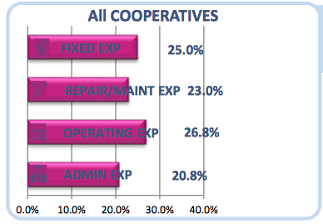
Variable Expenses
Notes:
Cooperative expense distribution of expenses remained consistent from year to year

Slide 33
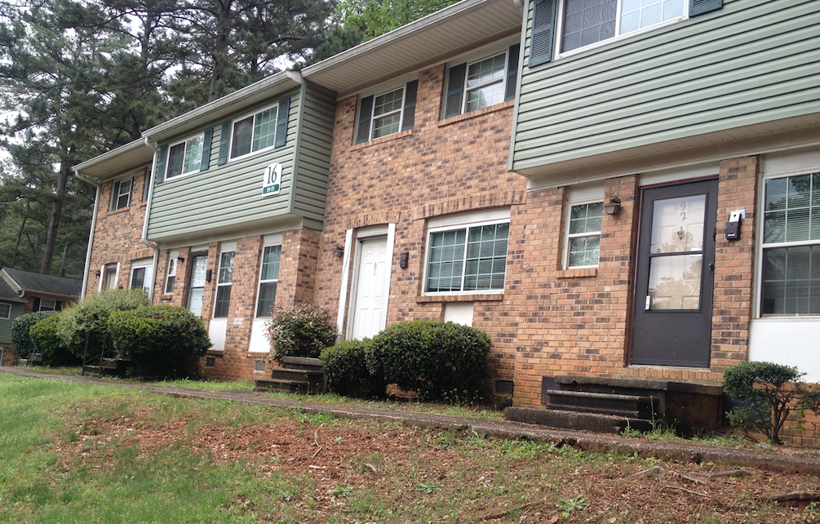
Variable Expenses
Notes:
Night Club being run by a Board Member!

Slide 34
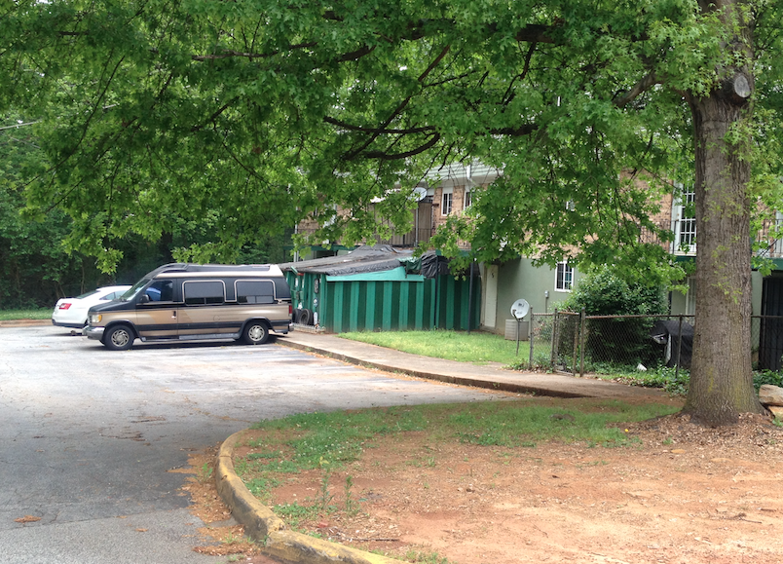
Variable Expenses
Notes:
Night Club being run by a Board Member!

Slide 35
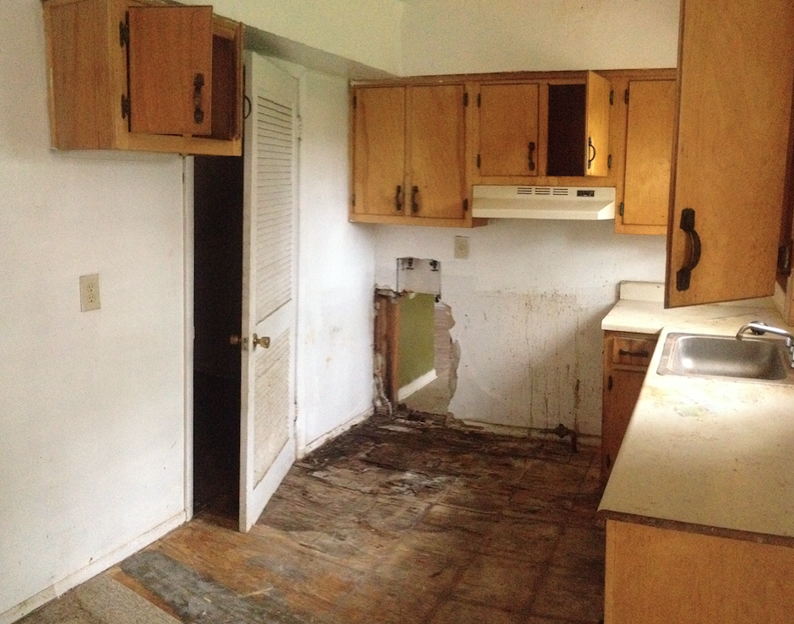
Variable Expenses
Notes:
Night Club being run by a Board Member!

Slide 36
Reserves for Replacement
Co-op Boards must decide how to fund the projected cost of repairs and replacements of the property's major components. There are two major options:
1) Accumulating funds over a period of time
2) Special assessments

Slide 37
Reserves for Replacement
Reserves for Replacement
Roofs
Balconies
HVAC, water heaters
Exterior façade
Elevators
Boilers
Parking Lots
The urban forest…

Slide 38
Reserves for Replacement
Have we Controlled Expenses
Taxes
Insurance
Maintenance
Staffing Levels
Management
Utilities
Parking Lots
Reserves

Slide 39
Reserves for Replacement
Conversion to Value or
Establishing value
NOI
FIXED
EXPENSES
REVENUE
VARIABLE
EXPENSES

Slide 40
Reserves for Replacement
Conversion to Value or
Establishing value
Components
CAPITALIZATION RATE
(Unearthed)
Interest Rate - Risk - Liquidity – Appreciation.
A Cap Rate is the mathematical relationship between net operating income and an asset’s value.
Assumed to be commonly extracted from transactions of buyers and sellers competing in a marketplace.
Sources of Rate Data PWC RE Investor Survey RealtyRates.com Valuation Insights and Perspectives

Slide 41
Reserves for Replacement
Sales Comparison Approach
GSO (GROSS SELL OUT) Considers the individual sale of each unit to different buyers. Typically uses Sales of Comparable Individual Units from several surrounding Cooperative improvements Can include tens to hundreds of sale prices (Observations) over a time period. Adjustments for differences in units are difficult to measure.
BULK SALE Considers the sale of the sum of all the units at once to one buyer. Typically uses apartment developments as comparables. Typically generates a lower value than the GSO approach. Uses Sales of Whole Developments Usually includes Five to Six Comparable Sales Adjustments are easier to measure based on whole building
Notes:
Down side
No two building are identical…
The sales are historical by their very nature
The amenities included and not just the age can be an issue
Locationally very different

Slide 42
Reserves for Replacement
Financing/Financial Management and Its Effects
Thank you for participating in this presentation
Notes:
Down side
No two building are identical…
The sales are historical by their very nature
The amenities included and not just the age can be an issue
Locationally very different

